Slide 1
Exploratory Data Analysis of Apps from Google Playstore
By- ARUN MATHAD
INSAID COHORT BATCH 2ND MARCH 2019

Slide 2
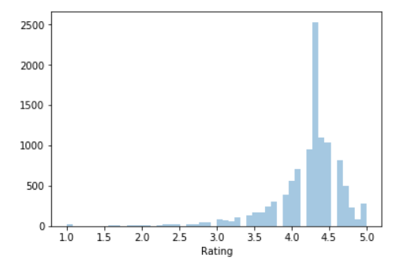
Distribution of ratings of apps
The distribution is highly skewed towards the right which implies there are lesser apps that have a very low rating
The distribution has high kurtosis indicating many of the apps are having a rating around 4.1 to 4.5

Slide 3
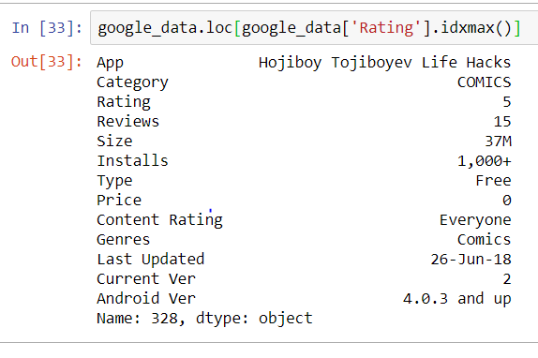
Lets find the highest rated app
The highest rated App is 'Hojiboy Tojiboyev Life Hacks' in the category of 'COMICS'

Slide 4
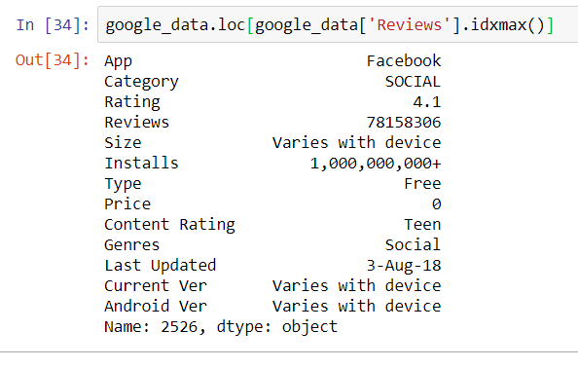
Lets analyze the app with maximum number of views
The app with maximum number of views is 'Facebook'

Slide 5
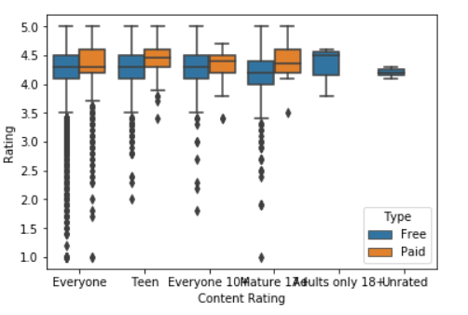
Lets analyze pricing on apps based on content rating
All the paid apps have a better rating in the content rating groups consisting of "Teen" , "Everyone" ," Mature 17+".

Slide 6
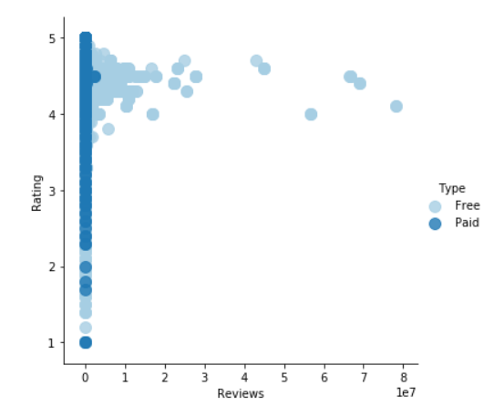
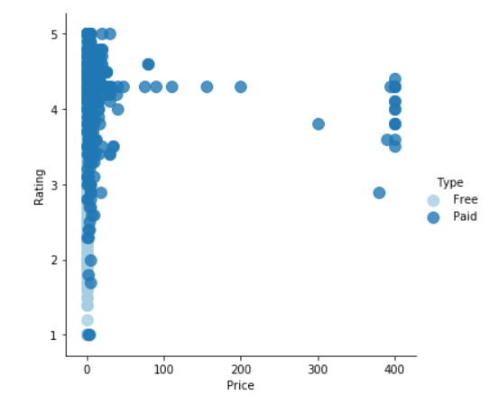
Data Visualization of Free and Paid Apps
Free Apps have more reviews compared to Paid Apps

Slide 7
THANK YOU

